Slide 1
Sphenopalatine Ganglion Blockade in the treatment of Head and Facial Pain
To join audio portion, call
1-800-309-2350
Conference ID 2175199
Stephen Eldredge, MD
Anesthesiology, Pain
Senior Medical Science Liaison
Director of Research and Publications
Dolor Technologies
Wade Cooper, DO
Director – Headache and Neuropathic Pain Clinic
Assistant Professor,
Departments of Neurology / Anesthesiology
University of Michigan

Slide 2
Disclosures
Wade Cooper, DO (Neurology / Headache Medicine)
Dolor Technologies
Director of Medical Education / Consultant
Consultant
Stephen Eldredge, MD (Anesthesiology / Pain)
Dolor Technologies
Senior Medical Science Liaison,
Director of Research and Publication
SphenoCath® is a trans nasal medication delivery device which can be facilitate an effective SPG and V2 blockade

Slide 3
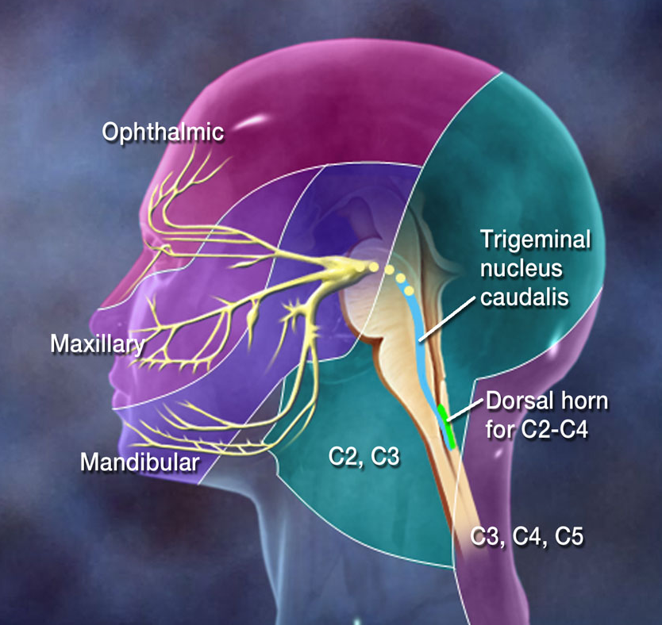
Headache Anatomy
Meningeal Nerves
Meningeal nerves
Innervate the lining of the brain (meninges)
First branches of the trigeminal nerves
V2 branch is middle meningeal nerve
Trigeminal nerves
Innervate the face and scalp
Transmit pain from the meninges to the brain
Trigeminal signals enter brain stem
Descend to the high cervical regions
Ascend to pain processing regions of the brain
Occipital nerves
Innervate occipital scalp
Contribute to trigeminal nucleus caudalis
Trigeminal Nerves
Trigeminal Nucleus Caudalis descends into cervical cord
Meningeal Nerves
First division of V1
First division of V2
First division of V3
Trigeminal Nucleus Caudalis
Trigeminal Nerves
Occipital nerves
Occipital nerves

Slide 4
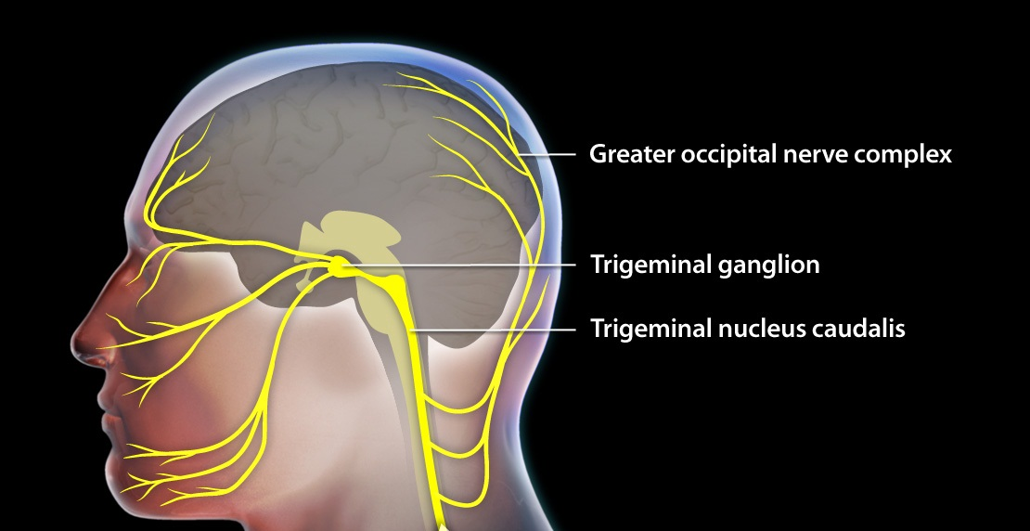
Trigeminal Nucleas Caudalis

Slide 5
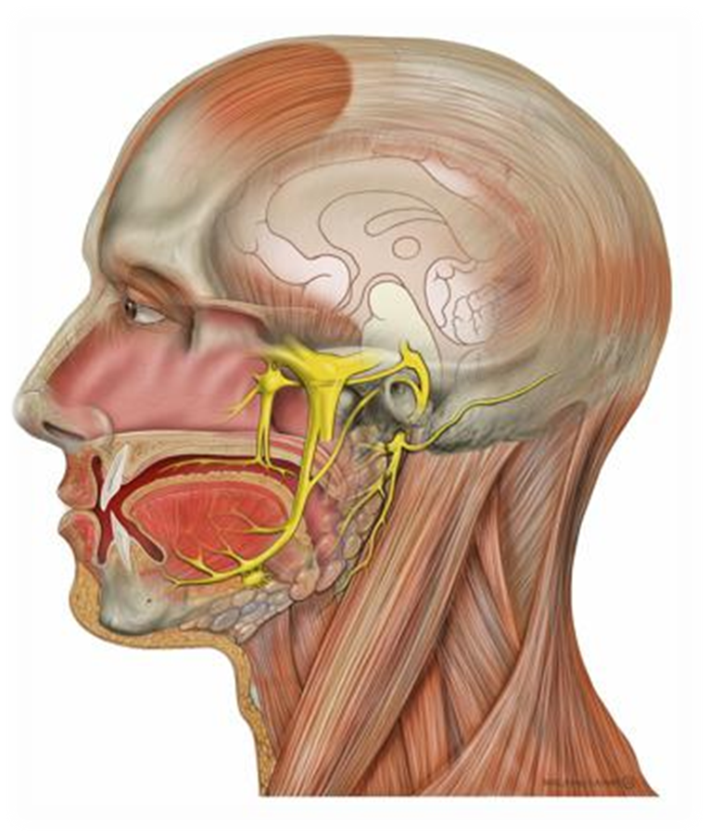
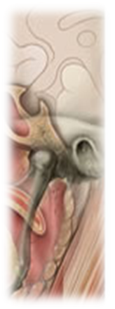
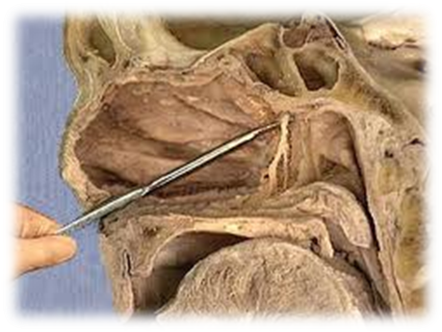
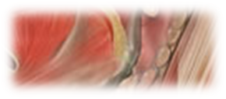
Sphenopalatine
Ganglion
4

Slide 6
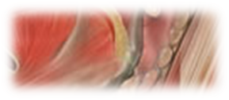
Sphenopalatine Ganglia Role in Head Pain
Trigeminal nociception
Part of Maxillary nerve (V2)
Branches to the Ophthalmic nerve (V1)
Middle Meningeal nerve
Innervates periorbital and parietal dura
SPG has nociceptive activity
5ht1D receptors
CGRP receptors
Sphenopalatine
Ganglia
(Csati et al., 2012)
(Ooman et al., 2011)
(Ivanusic et al., 2011)

Slide 7
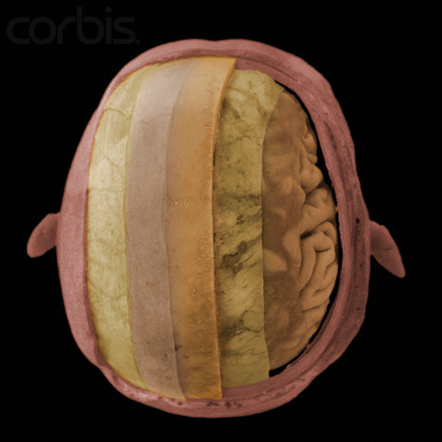
Autonomic influence on the Dura mater
Dense network of autonomic and sensory fibers within the Dura Mater
Sympathetic stimulation (Norepinephrine) shows increased PGE2 and reduced serotonin
Ebersberger A et al. Effect of sympathetic and parasympathetic mediators on the release of calcitonin gene-related peptide and prostaglandin E2 for rat dura mater in vitro. Cephalalgia. 2006: 26:282-289.

Slide 8
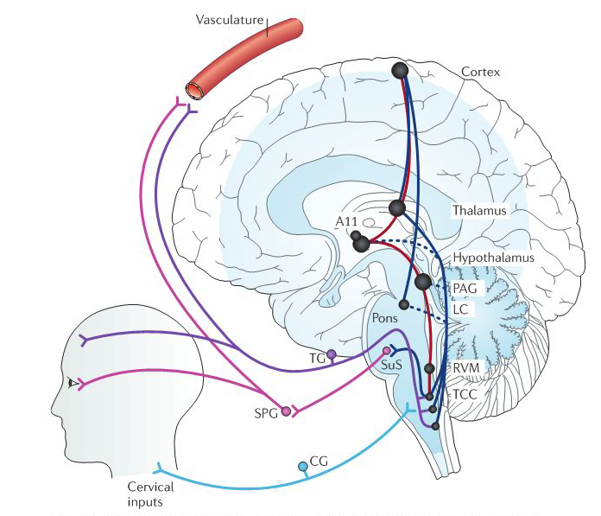
SPG Circuit - Role in Migraine
Autonomic Nervous System
Parasympathetic Component
Meningeal Vasodilation
Neurogenic Inflammation
Clinical signs
Facial fullness
Lacrimation
Nasal edema
Sympathetic Component
Cerebral vasoconstriction
Sphenopalatine
Ganglion
Akerman S, Holland PR, Goadsby PJ. Diencephalic and Brainstem Mechanisms in Migraine. Nat Rev Neurosci. 2011; 12:570-84..

Slide 9
SPG Circuit - Treatment
Local anesthetic blockade may terminate Migraine or Cluster
Reduced pain signals from dura
middle meningeal nerve
Autonomic nervous system effects
↓ Neurogenic inflammation
↓ Meningeal vasodilation

Slide 10
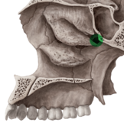
Sphenopalatine Foramen
3 mm of connective tissue / mucous membrane
Connects nasal passages to pterygopalatine fossa
Transmits vessels and nerves from the pteryogopalatine fossa

Slide 11
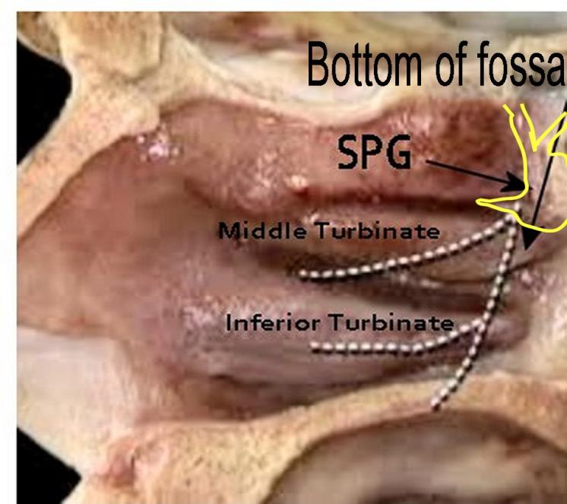
The Yellow line traces primary SphenoCath injectate filling pattern visible under fluoro. The central SPG (proper) exposes para sympathetic fibers of the “V2/SPG circuit”.

Slide 12
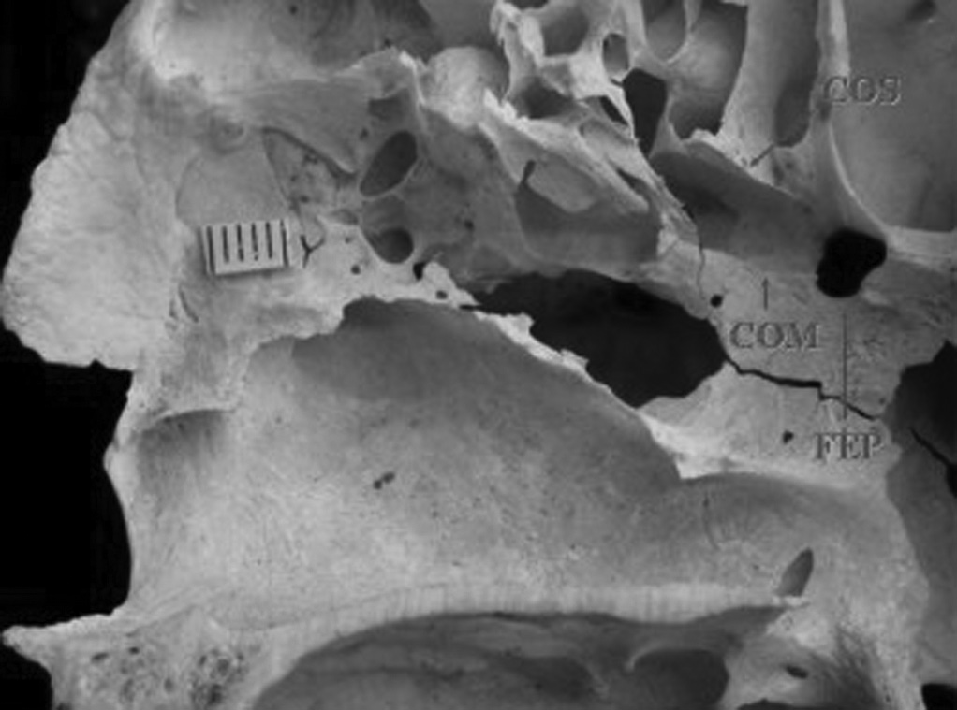
Sphenopalatine foramen is located above middle turbinate
Sphenopalatine
Foramen
Cadaver study examined location of sphenopalatine foramen
(N=54 hemi skulls)
At superior turbinate
= 81.5%
Between middle
& sup. turbinate
= 14.8%
At middle turbinate
= 01.9%
Sup. Turb.
Middle Turb.
Inferior. Turbinate
Scanavine ABA, Navarro JAC, Megale SRM, Anselmo-Lima WM. Anatomical study of the sphenopalatine foramen. Brazilian Journal of Otolaryngology. 2009;75(1):37-41.

Slide 13
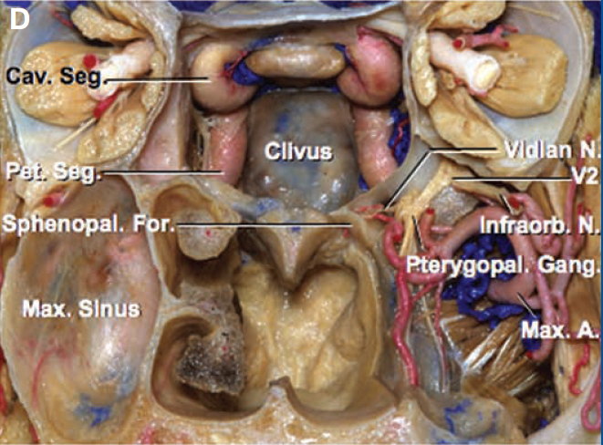
Sphenopalatine Foramen
Sphenopalatine
Ganglion

Slide 14
Yarnitsky D, Goor-Aryeh I, Bajwa ZH, Ransil BI, Cutrer FM, Sottile A, Burstein R. 2003 Wolff Award: Possible parasympathetic contributions to peripheral and central sensitization during migraine. Headache 2003;43:704-714

Slide 15
Cranial Autonomic Parasympathetic Symptoms in Chronic Migraine
82% reported at least one CAPS
Lacrimation 49%
Conjunctival inj. 44%
Eyelid edema 39%
Ear fullness 30%
Nasal congestion 20%
Eyelid ptosis 42%
(Cranial Sympathetic Autonomic Symptom)
Riesco N, Perez-Alvarez AI, Verano L, Garcia-Cabo C, Martinez-Ramos J, Sanchez-Lozano P, Cernuda-Morollon E, Pascual J. Prevalence of cranial autonomic parasympathetic symptoms in chronic migraine: Usefulness of a new scale. Cephalalgia. 2015.

Slide 17
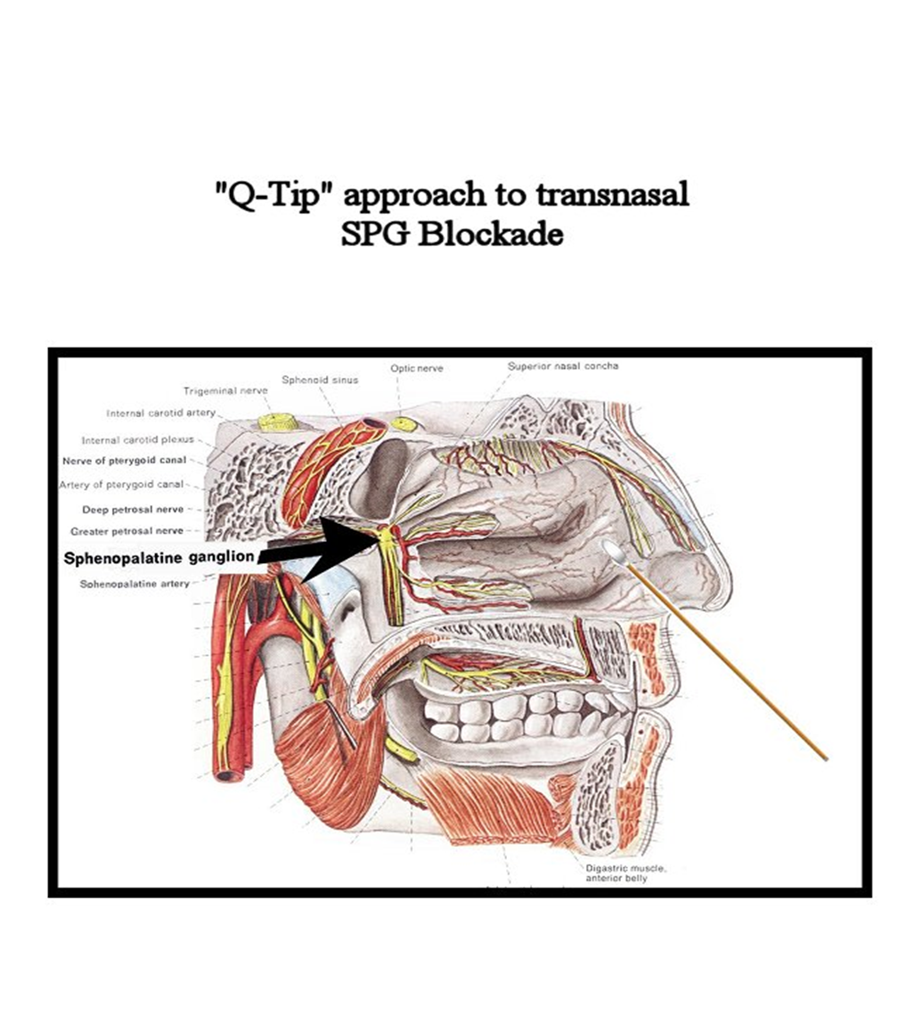
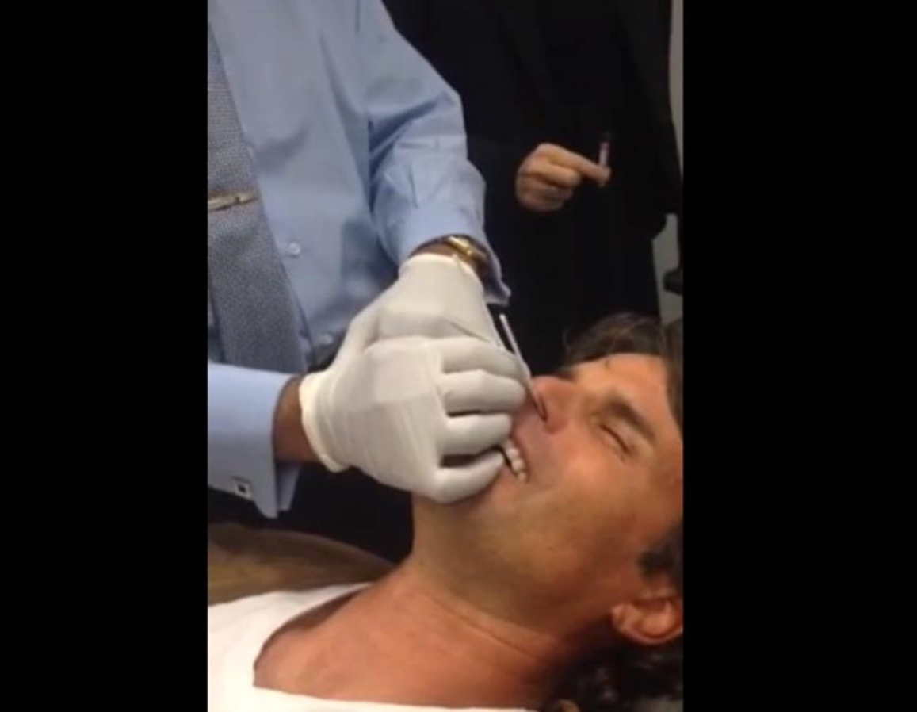
How have these procedures been attempted under past conventional methods?

Slide 18
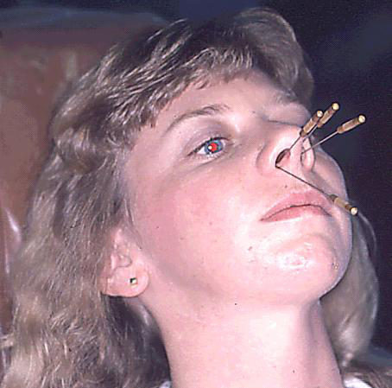
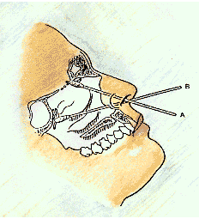
Sphenopalatine Ganglion Block Intranasal Rigid Applicator (Q-tip)
Topical anesthetic near SPG
Minimally invasive
Duration - 1 day to 6 weeks
Nasal anatomy does not permit easy placement
Turbinates block access
Lateral location of sphenopalatine foramen

Slide 19
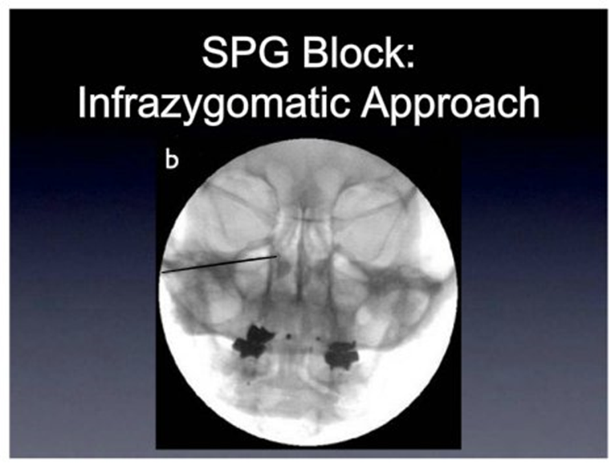
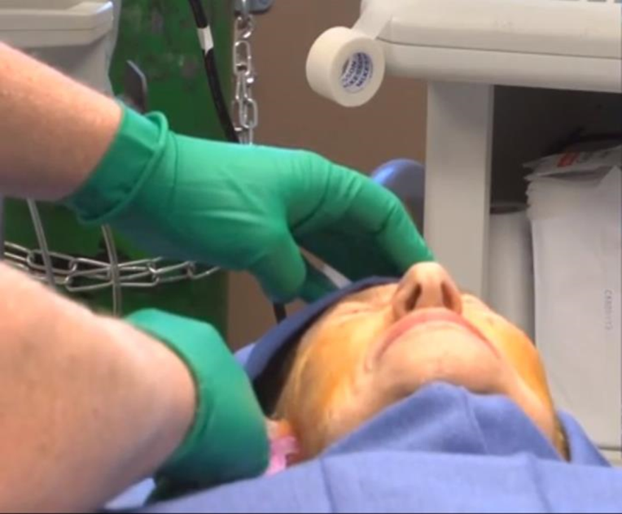

Slide 20
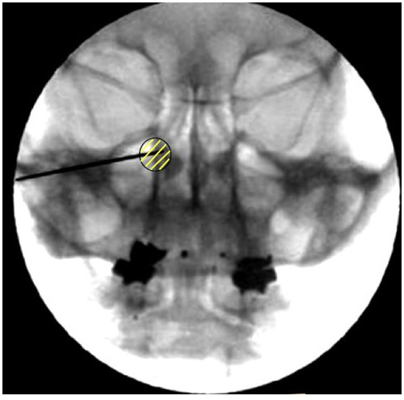
Sphenopalatine Ganglion Block Infra-Zygomatic Approach
Long needle advanced to pterygoid plate
Injection of medication to the pterygopalatine fossa
Relative poor tolerability
Risk of hemorrhage
Needle trauma
Pain

Slide 22
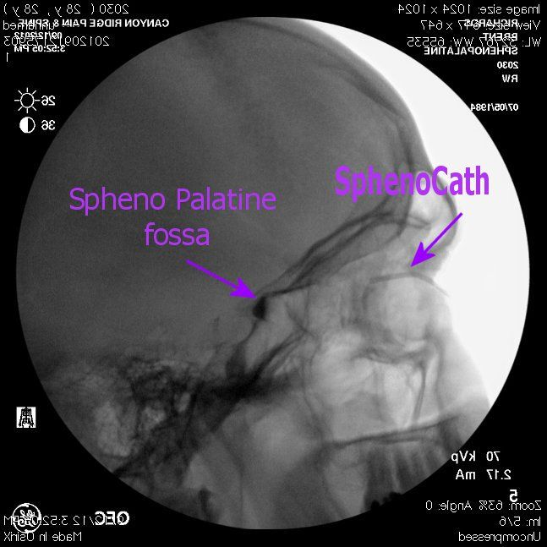
Above Middle Turbinate Approach
Above middle turbinate approach
Injectate (contrast) fills sphenopalatine fossa

Slide 23
Pterygopalatine Fossa
Sphenopalatine
ganglion

Slide 24
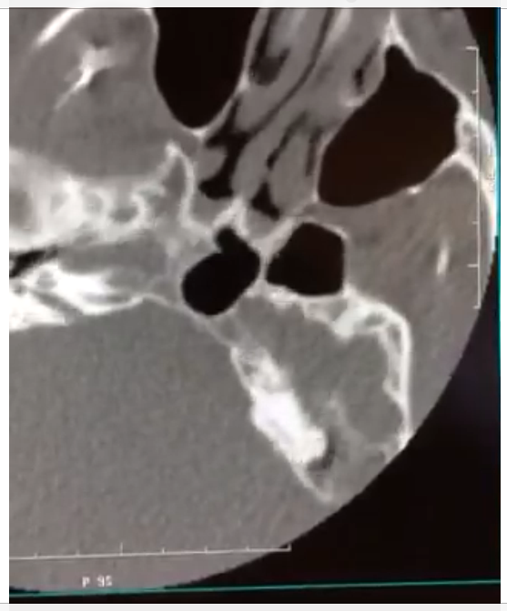
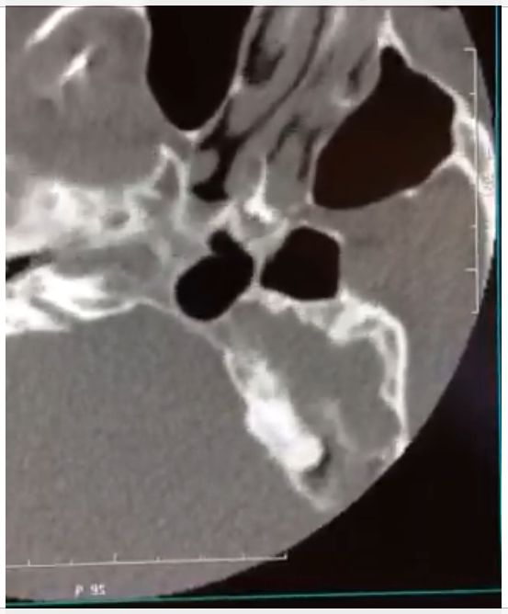
Injectate at the Sphenopalatine Foramen
Sphenopalatine
Foramen
Contrast
injectate
CT axial image of SPF
Injectate of contrast at SPF

Slide 25
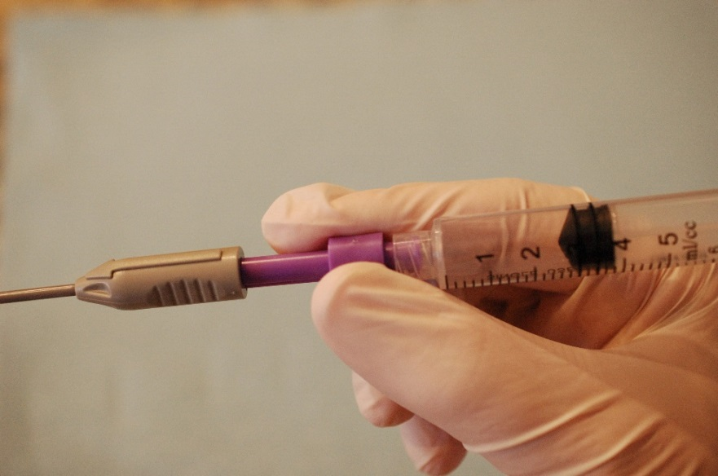
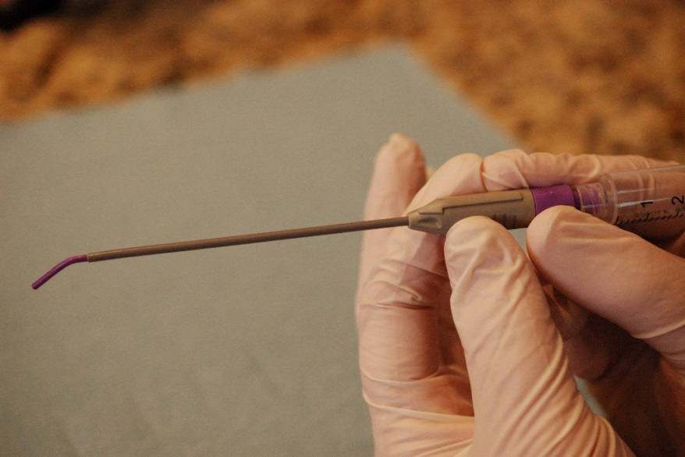

Slide 26
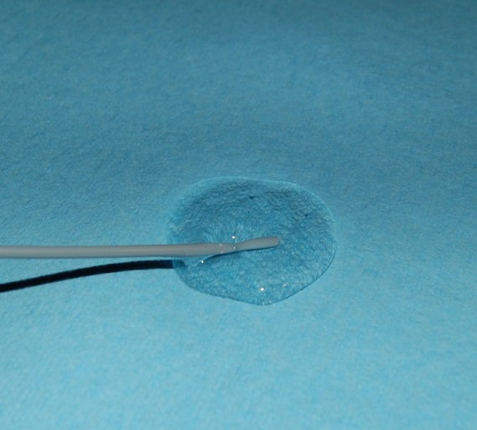

Slide 27
How do I do this procedure?
Patient is supine on procedure table
Towel or pillow is placed under shoulders to extend jaw and nose upward as far as comfortable for patient
Apply temperature strips & record temp
Pre-procedure treatments
Explain to patient importance of keeping head still throughout procedure

Slide 28
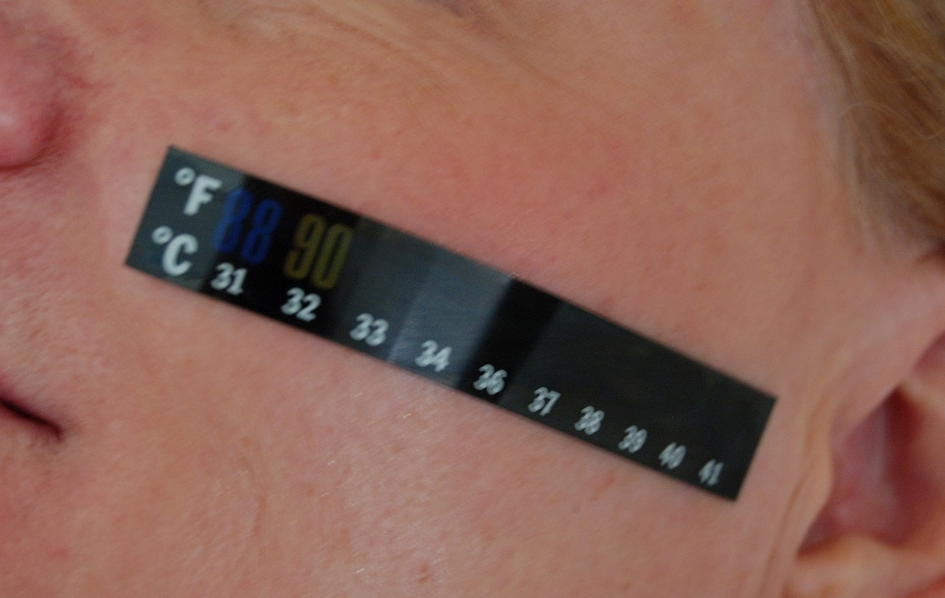

Slide 29
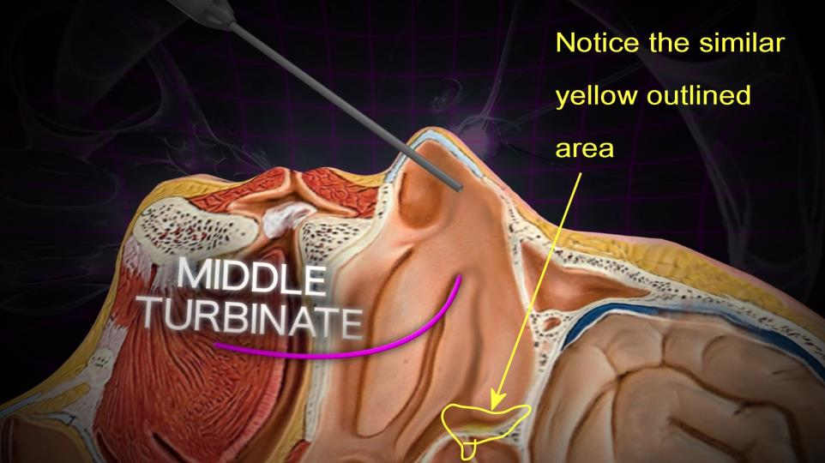
While the patient is laying supine, gravity will facilitate infused medication to collect and saturate the targeted area… IF, the medication is dispersed over the top of the middle turbinate.

Slide 30
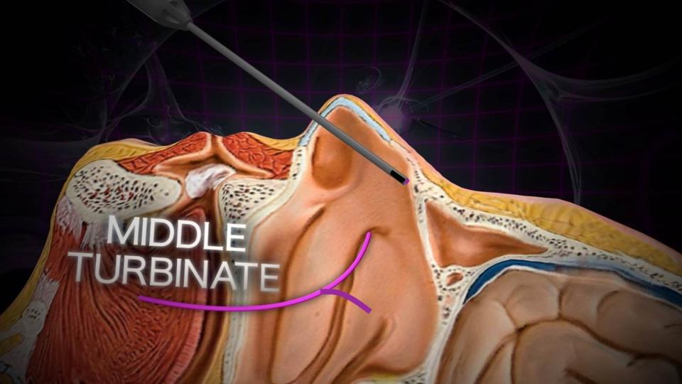
The catheter is placed into the nostril, and advanced to the point of resistance.

Slide 31
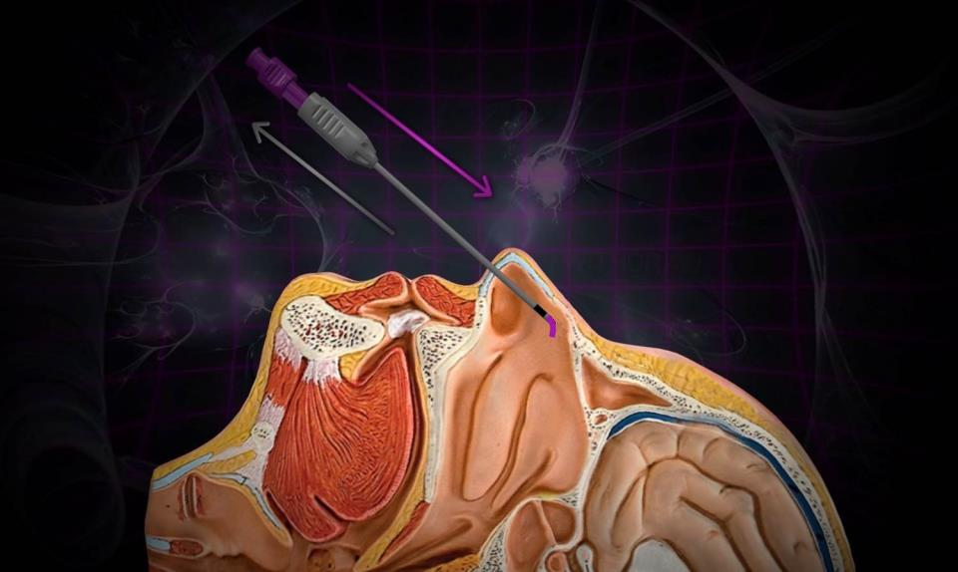
Gently bring the grey hub back towards the purple injection port

Slide 32
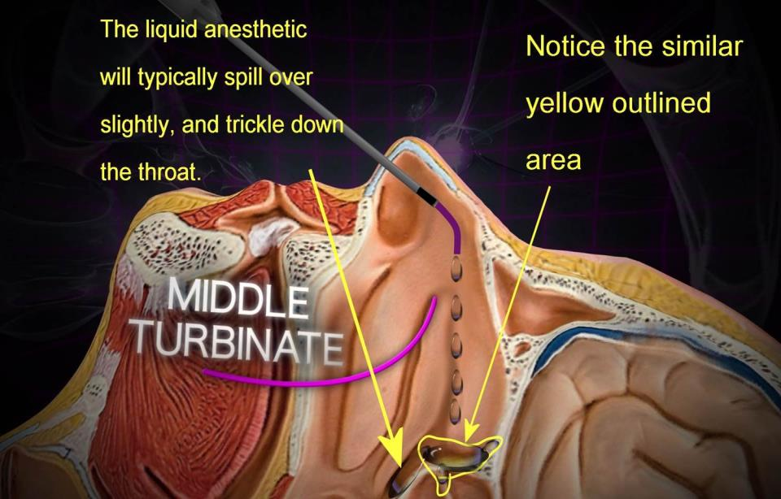

Slide 33
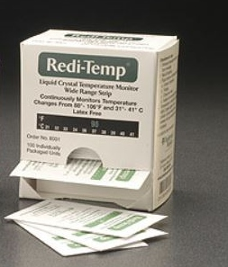
SphenoCath® Procedure Pick Sheet (continued)
Temperature Strips - We have been using Redi-Temp strips from TradeMark Medical

Slide 34
SPG Block - Clinical Autonomic Effects
Physiologic manifestations of “blocking” components of cranial autonomic circuit:
Cutaneous temperature changes
Typically ipsilateral cheek ↑ 3-5° F
Tearing
Lateral canthus of ipsilateral eye Occurs within seconds
Facial erythema

Slide 35
SPG Block - Clinical Autonomic Effects
Cutaneous temperature monitoring at zygoma
SPG block via intranasal catheter – 63 cases
Left cheek
Pre treatment = 32.6°C
Post treatment = 35.4°C
Difference = 2.8°C
Right cheek
Pre treatment = 32.3°C
Post treatment = 35.0°C
Difference = 2.7°C
Cooper, WM. Etal U of Michigan

Slide 36
Adverse Events from intranasal SPG block
Temporary numbness of the throat
Headache initiation / escalation
Temporary dizziness
Inadvertent injectate into the eustacian tube
Do not rotate head when delivering injectate
Resolves in minutes/hours
Very rare
Autonomic effects from SPG block
Typically occurs hours after.
May >24 hours
Described as unsteady or spacey

Slide 37
Why use SPGB, or central autonomic/V2 blockade?
Literature based indications:
Chronic and Episodic Migraine
Trigeminal Neuralgia
Trigeminal Neuritis (Including root canal pain)
Cluster Headaches (Other TAC syndromes)
*Medication overuse headache
Post concussive headaches /sports medicine-delayed impact
Pregnancy (Migraine)
Post Dural puncture
MS
Chiari
others
Cohen, S, et al. A new interest in an old remedy for headache and backache for our obstetric patients: a sphenopalatine ganglion block. Anaesthesia, 2000, 56, 606-07, http://onlinelibrary.wiley.com/doi/10.1111/j.1365-2044.2001.2094-34.x/full.
Quevedo, JP, et al. Complex Regional Pain Syndrome Involving the Lower Extremity: A Report of 2 cases of Sphenopalatine Block as a Treatment Option. Arch Phys Med Rehabil. 2005 Feb; 86(2): 335-37, http://www.ncbi.nlm.nih.gov/pubmed/15706564.
Cohen, S, et al. Sphenopalatine ganglion block for postdural puncture headache. Anaesthesia, 2009, 64, 574.
Notes:
Broad clinical response to SPGB bespeaks the broader notion of neuromodulation of the sphenopalatine complex.

Slide 38
Conclusions
The Sphenopalatine Ganglia play a vital role in headache
Trigeminal nociception
Parasympathetic pathway
Sympathetic pathway
Intranasal anesthestic blockade may be an effective option for those with headache or facial pain

Slide 39
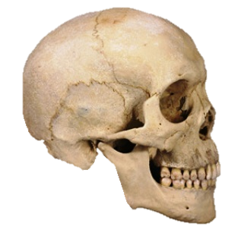
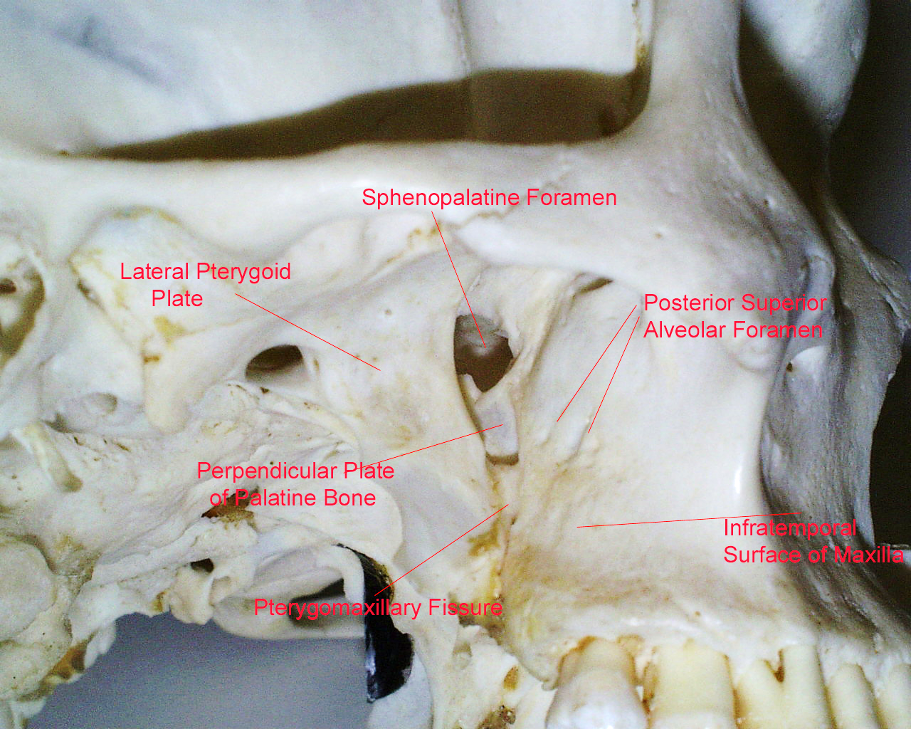
Pterygopalatine Fossa Anatomy

Slide 40
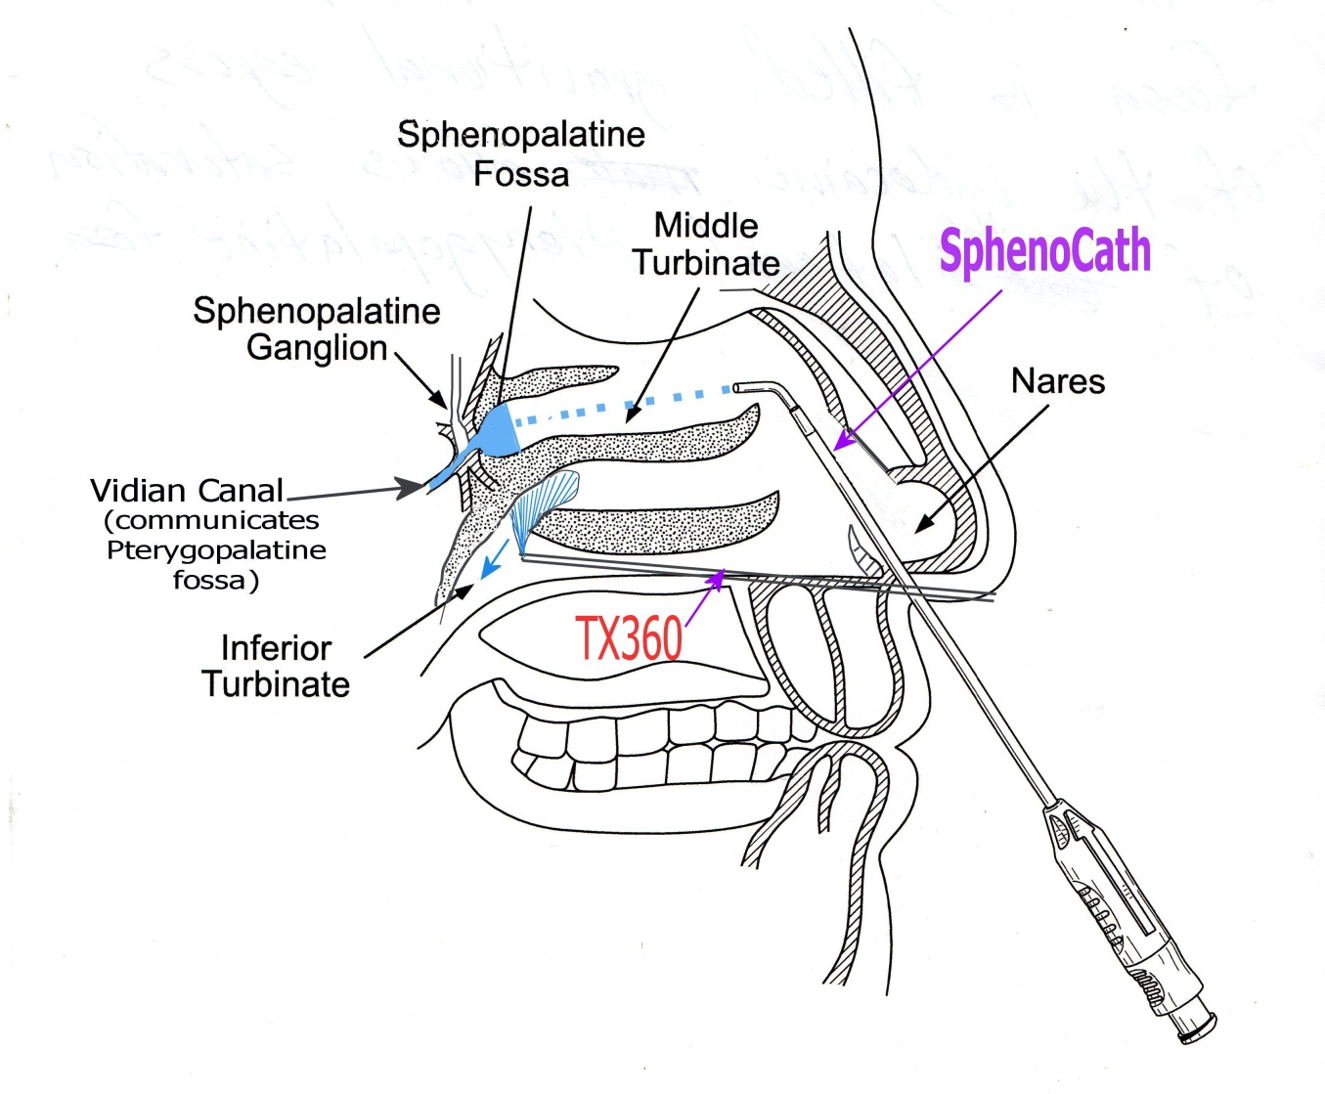
Sphenopalatine foramen dispersion is key to procedure
Above middle
turbinate approach
Under inferior
turbinate approach

Slide 41
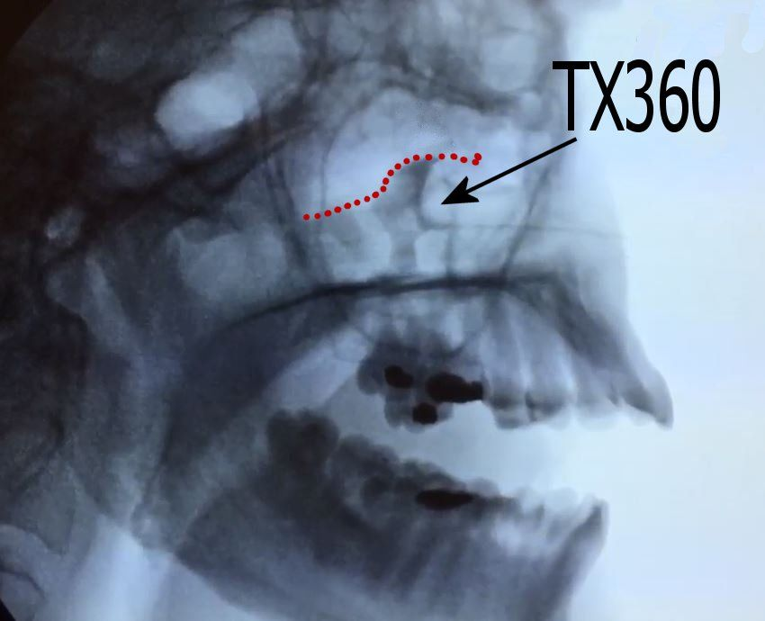
Below Inferior Turbinate Approach
Injectate (contrast) Does not fill sphenopalatine fossa
Below Inferior turbinate approach

Slide 42
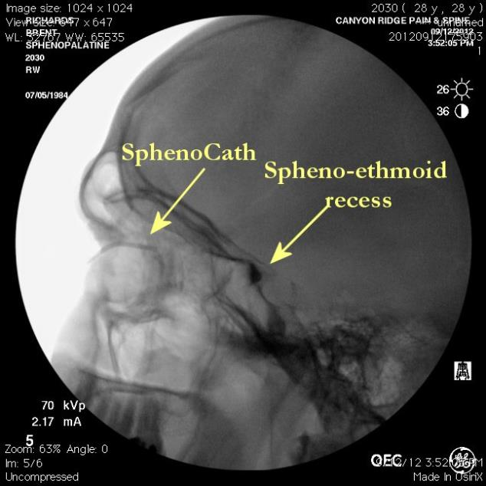
Filling studies from the SphenoCath tm radio contrast images demonstrate remarkable saturation of the entire SPG Circuit.

Slide 43
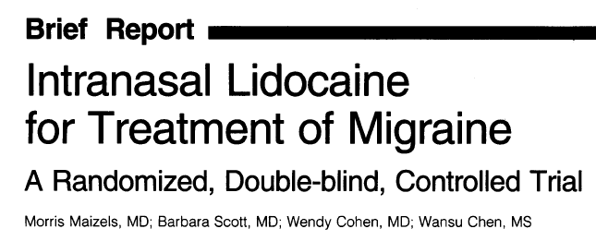
Reduced pain by 50%
Treatment Placebo
55% 21%
Treatment group
↓ Nausea
↓Photophobia
Urgent Care Setting
Acute migraine
Treatment group
Intranasal lidocaine 4%
1cc per nostril
Placebo group
Normal saline
Maizels M, Scott B, Cohen W, Chen W. Intranasal Lidocaine for Treatment of Migraine – A Randomized, Double-blind, Controlled Trial. JAMA, 1999; 276(4):319-21

Slide 44
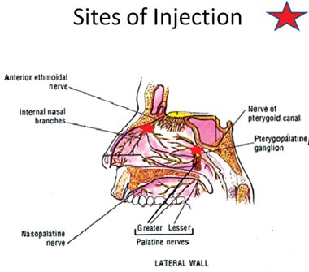
Endoscopic neural blockade for rhinogenic headache and facial pain
Retrospective chart review
882 procedures
147 patients
Endoscopic neural blockade
Needle injection
Sphenopalatine foramen
Anterior ethmoid region
Both
81.3% improvement
17.9% unchanged
00.8% worse
Complications
4 mild
2 moderate
No severe
Rodman R & Dutton J. Endoscopic neural blockade for rhinogenic headache and facial pain: 2011 update. International Forum of Allergy & Rhinology. 2(4)2012:325-330.

Slide 45
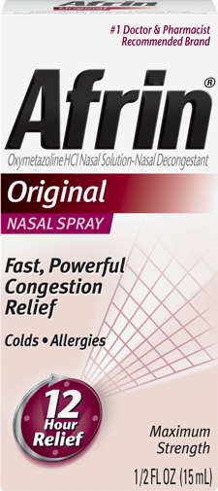
SphenoCath® Procedure Pick Sheet (continued)
Optional: Afrin for pre-procedural use to reduce nasal mucosa inflammation to allow greater access for SphenoCath® device and anesthetic agent

Slide 46
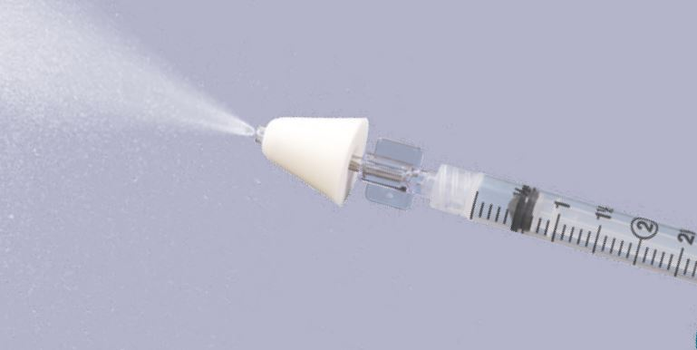
SphenoCath® Procedure Pick Sheet (continued)
Optional: an atomizer to numb the nasal passageways. The preferred atomizer is from Teleflex-LMA Medical, Description - Nasal Intranasal Mucosal Atomizer, Part Number - MAD300.

Slide 47
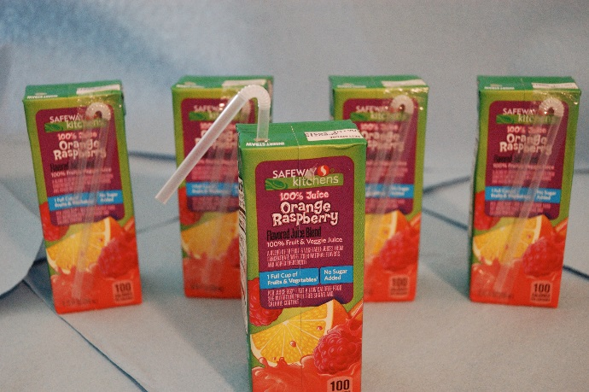
SphenoCath® Procedure Pick Sheet (continued)
12. Optional: juice box with straw for sipping while patient is supine during procedure

Slide 48
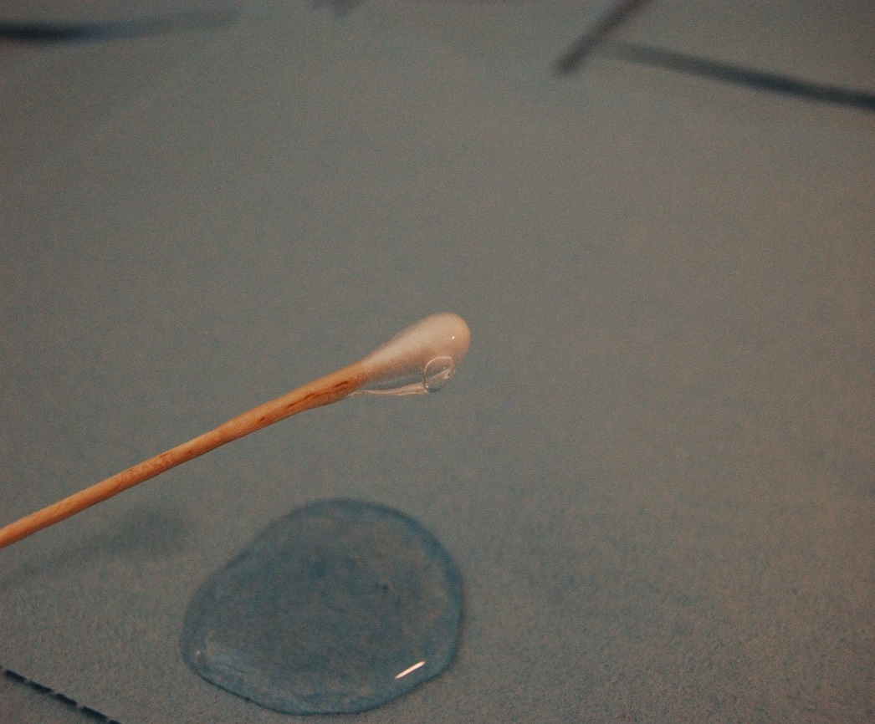

Slide 50
